Slide 1

Future Vehicle Education Workshop
Subject: Environment Setting
Automation Lab.

Slide 2


PC
PC Hardware Environment
Operating System: Window10
Architecture: x86, x64

Slide 3
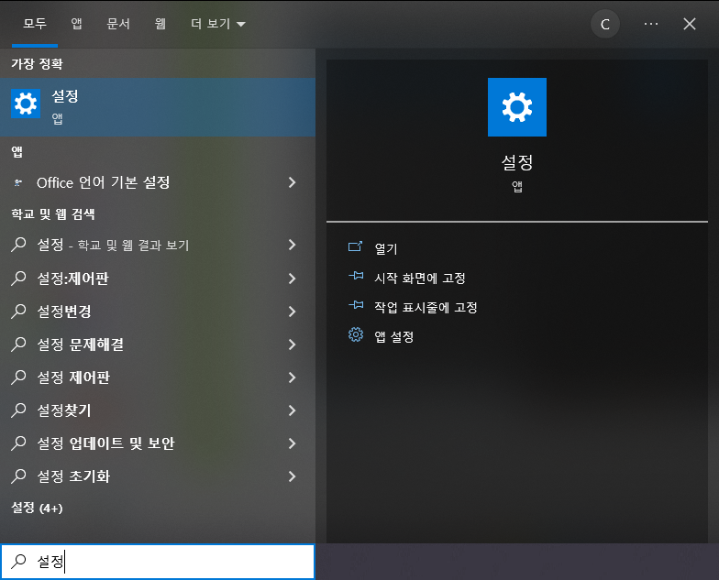
PC
Check your PC's hardware specifications
Click

Slide 4
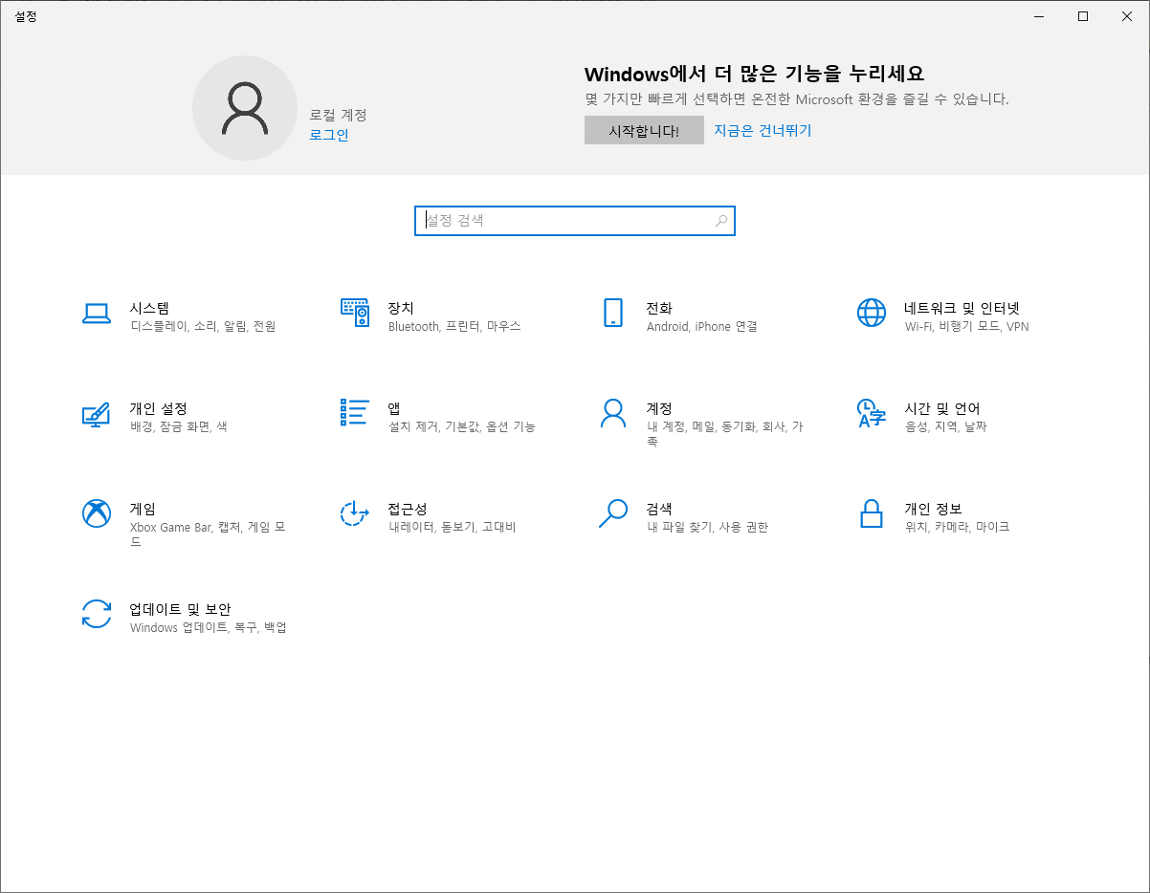
PC
Check your PC's hardware specifications
Click

Slide 5
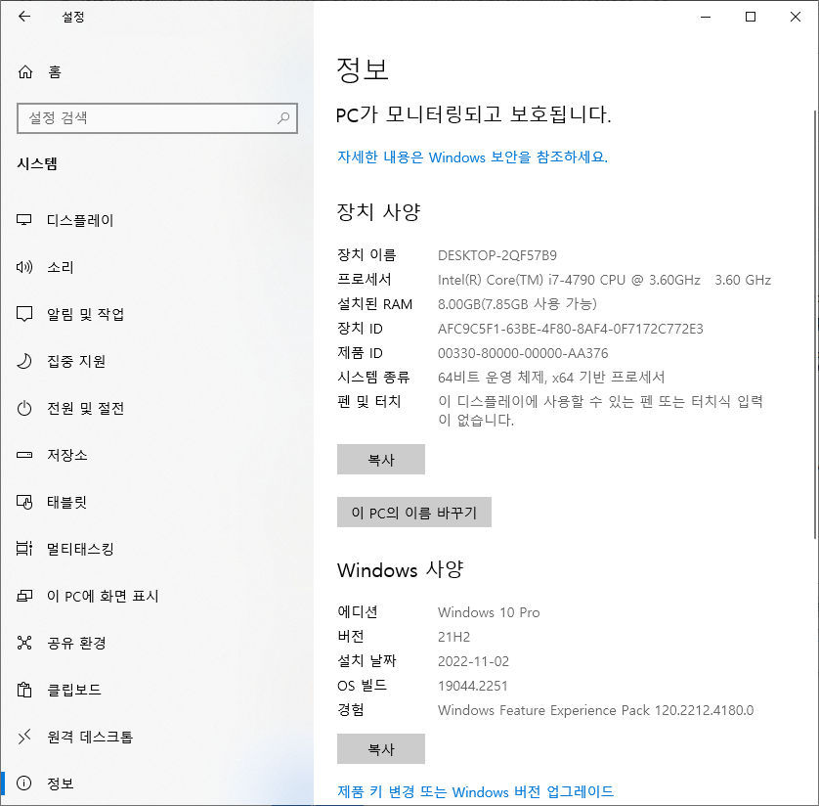
PC
Check your PC's hardware specifications
Click

Slide 6
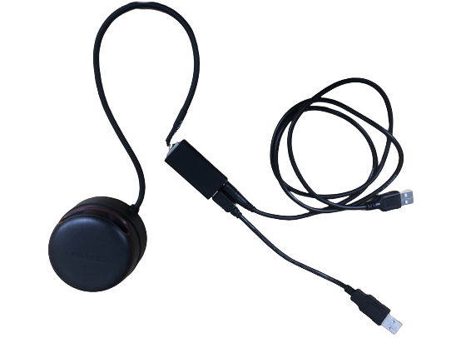
LiDAR
LiDAR
Connect the short wire to the PC

Slide 7
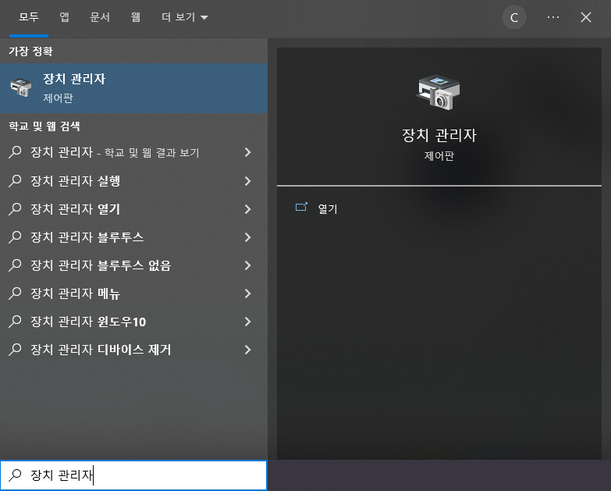
LiDAR
Verify Lidar Device Connection
Click

Slide 8
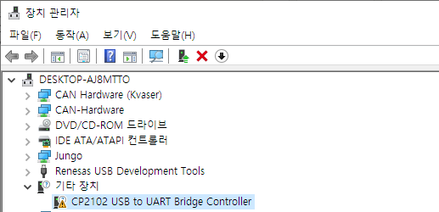
LiDAR
Verify Lidar Device Connection
Other Device CP2102 USB Recognition Checks
If not recognized, check the lidar USB port connection

Slide 9
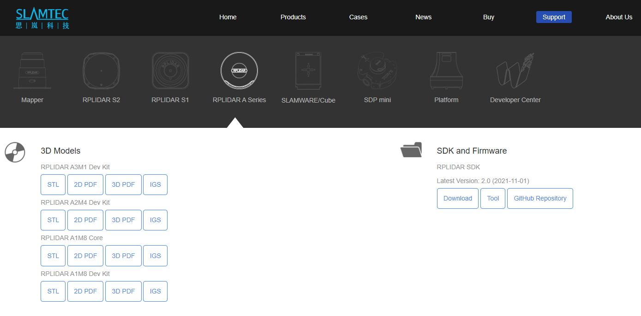
LiDAR
Install LiDAR Driver
Download page:
https://www.slamtec.com/en/support#rplidar-a-series
Click
Path: SDK and Firmware - RPLIDAR SDK - Download

Slide 10
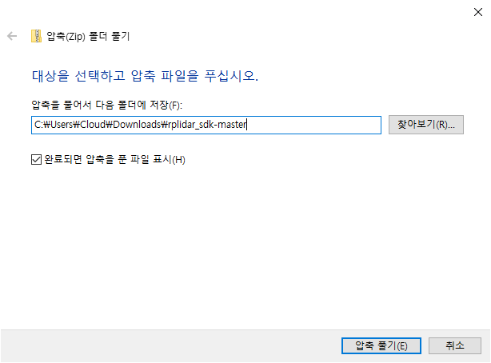
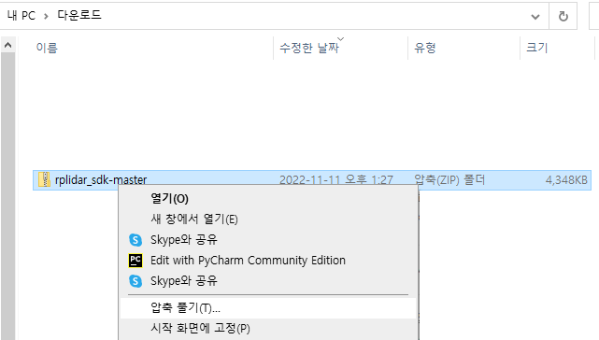
LiDAR
Install LiDAR Driver
Click
Click

Slide 11
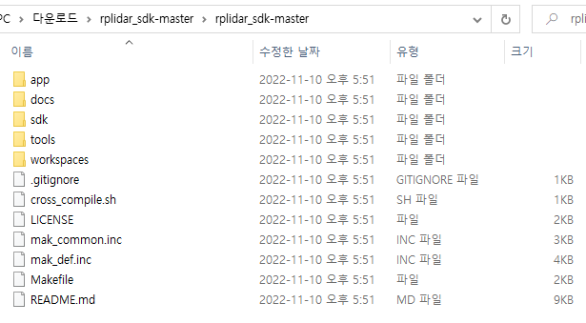
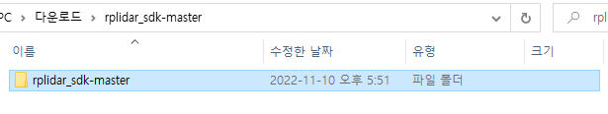
LiDAR
Install LiDAR Driver
클릭
클릭

Slide 12
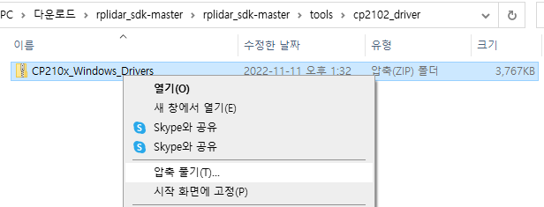
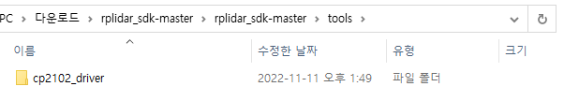
LiDAR
Install LiDAR Driver
Click
Click

Slide 13
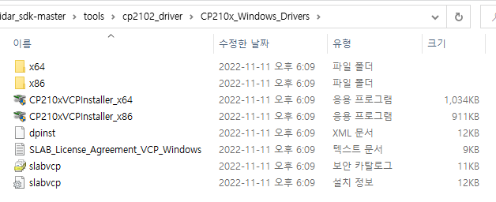
LiDAR
Install LiDAR Driver
Run programs that meet your PC's specifications

Slide 14
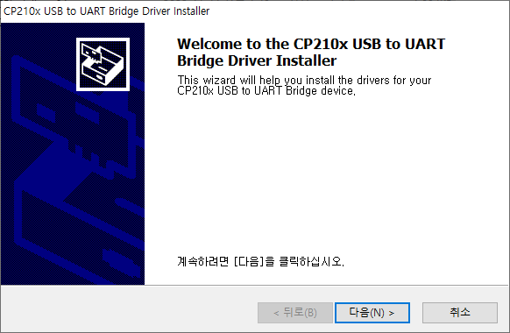
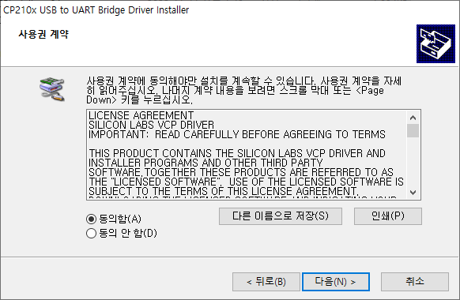
LiDAR
Install LiDAR Driver
Click
Check Agree, then click Next

Slide 15
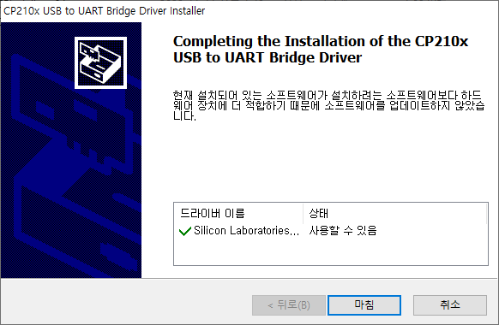
LiDAR
Install LiDAR Driver
Click

Slide 16
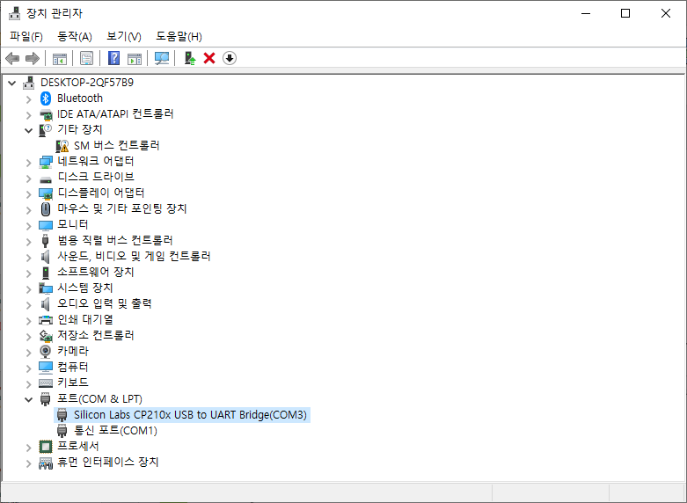
LiDAR
Install LiDAR Driver
Device Manager – port(COM & LPT)
CP2102 USB Recognition check

Slide 17
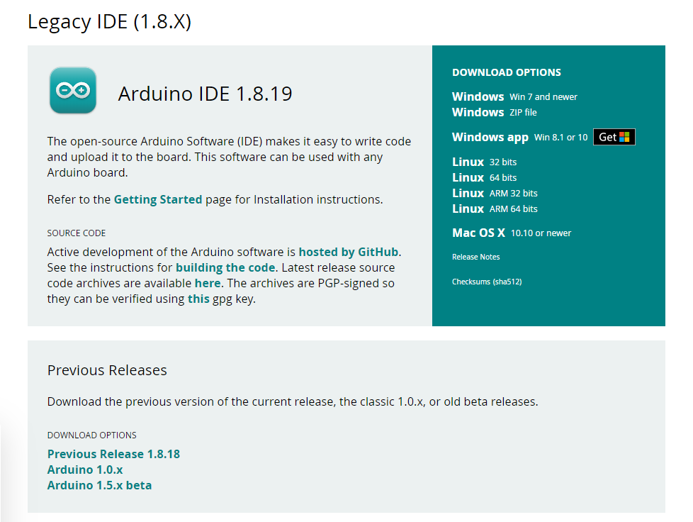
Arduino IDE
Install Arduino IDE
Download page:
https://www.arduino.cc/en/software
Arduino IDE 1.8.19
Version check
Click and Download

Slide 18
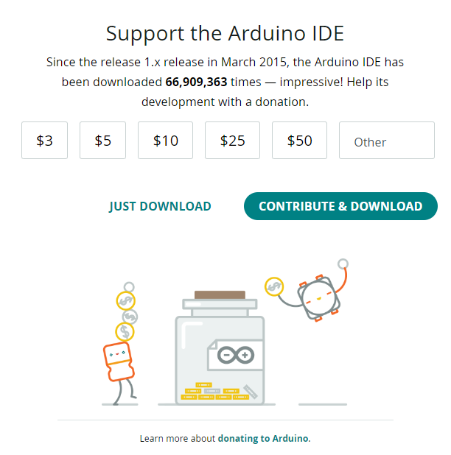
Arduino IDE
Install Arduino IDE
Click

Slide 19
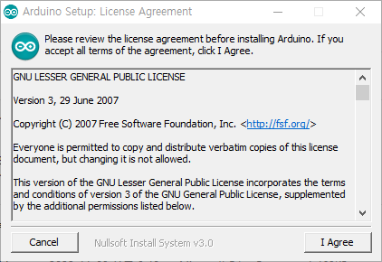
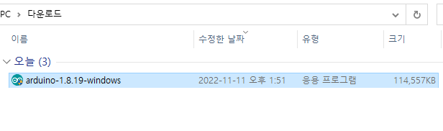
Arduino IDE
Install Arduino IDE
Click
Click

Slide 20
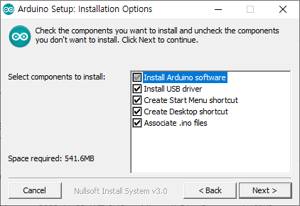
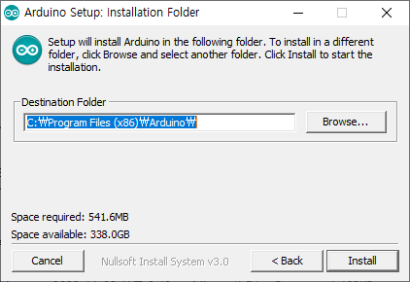
Arduino IDE
Install Arduino IDE
Check ALL
Click
Click

Slide 21
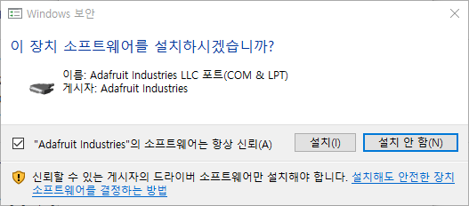
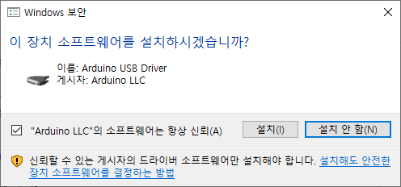
Arduino IDE
Install Arduino IDE
Device Software Installation Notification Appearing, Install All
Click
Click

Slide 22

Arduino IDE
Install Arduino IDE
Device Software Installation Notification Appearing, Install All
Click

Slide 23
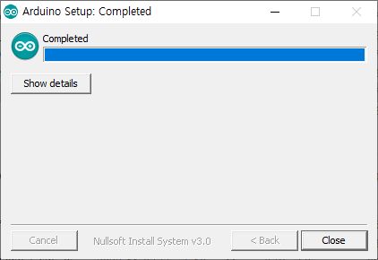
Arduino IDE
Install Arduino IDE
Click

Slide 24
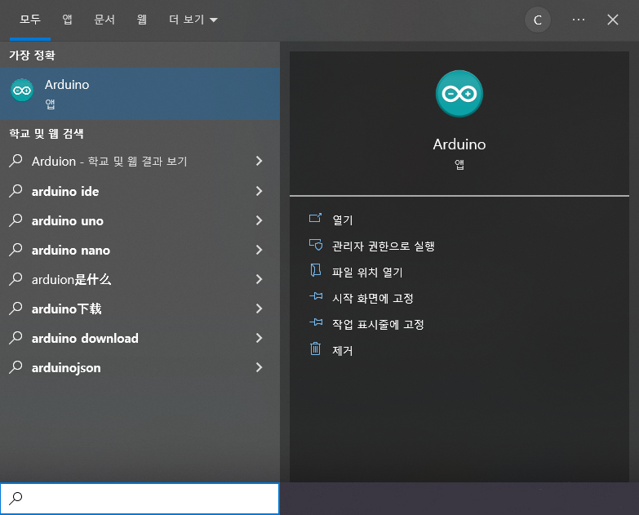
Arduino IDE
Install Arduino IDE
Run Arduino

Slide 25
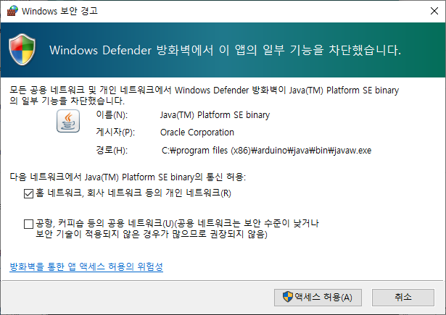
Arduino IDE
Install Arduino IDE
Private Network Check
Click

Slide 26
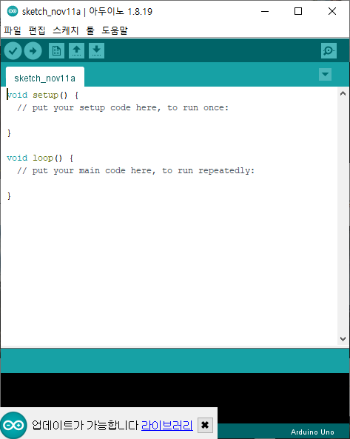
Arduino IDE
Arduino IDE Initial screen

Slide 27
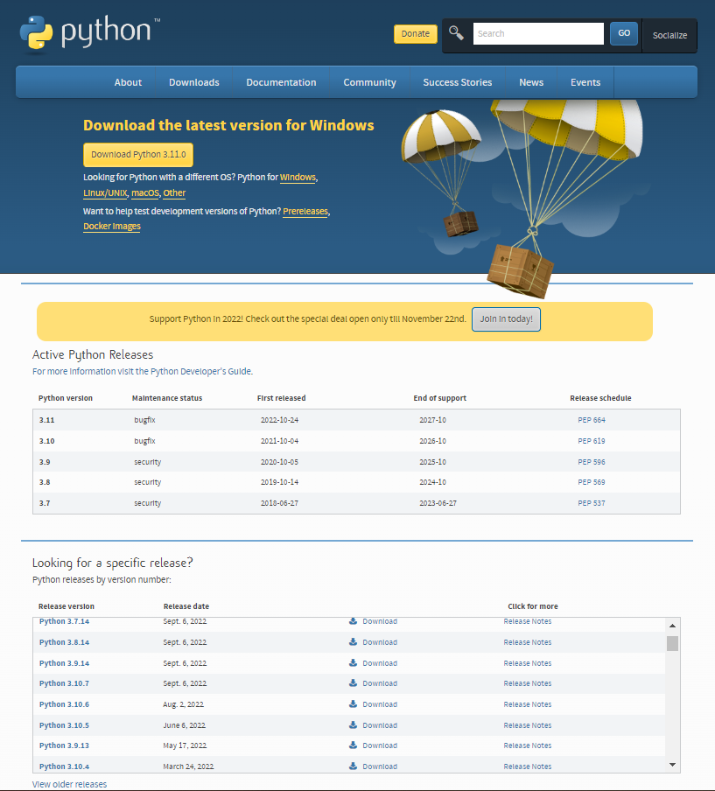
Python
Install Python
Download Page:
https://www.python.org/downloads/
Choose version and download

Slide 28
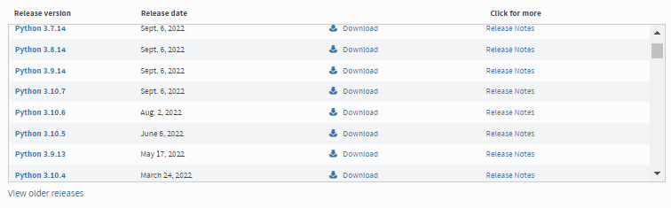
Python
Install Python
Download Page:
https://www.python.org/downloads/
Version 3.9.13 Click Download

Slide 29
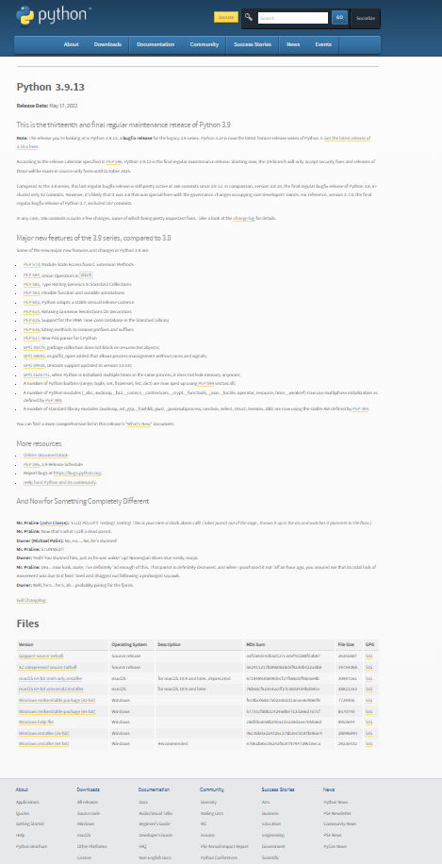
Python
Install Python
Check the “Files”

Slide 30
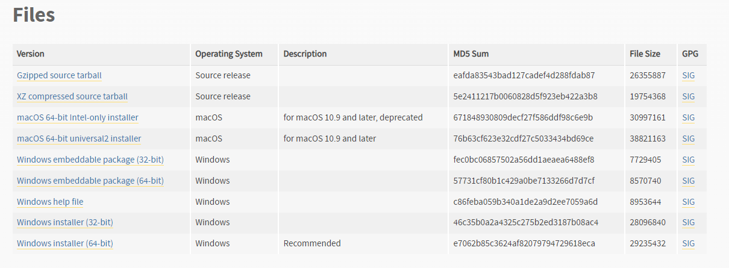
Python
Install Python
Select your PC hardware specifications (64-bit, 32-bit)
Hardware Specifications
Check out the first part of this document (page 5)

Slide 31
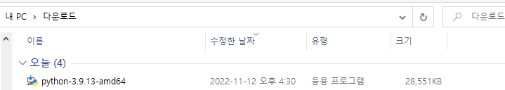
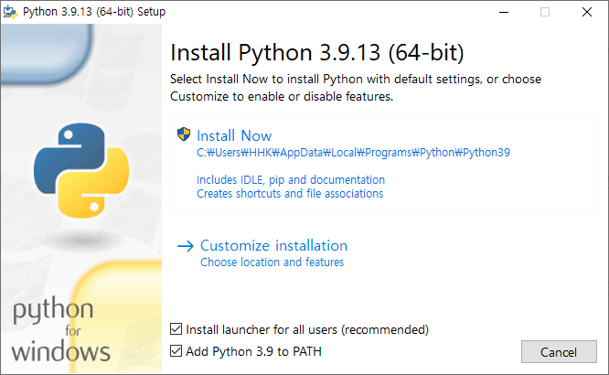
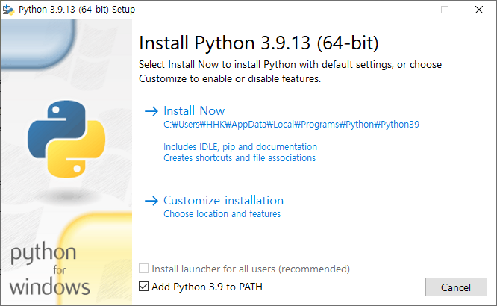
Python
Install Python
Click
Click
Click
If both checkboxes are enabled
Check both
If only one is active Check only the following

Slide 32
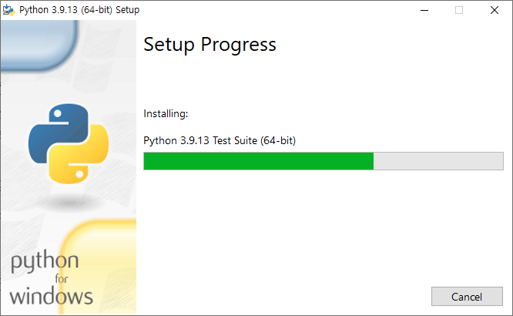
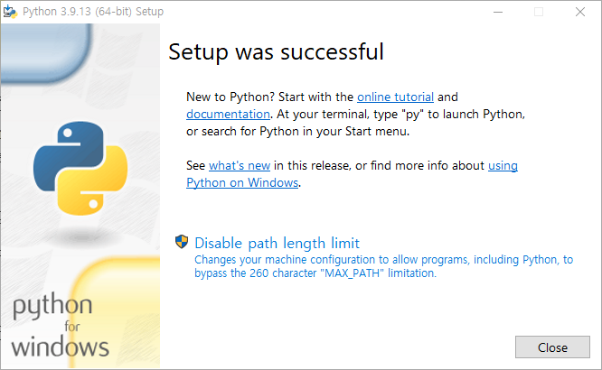
Python
Install Python
Click

Slide 33
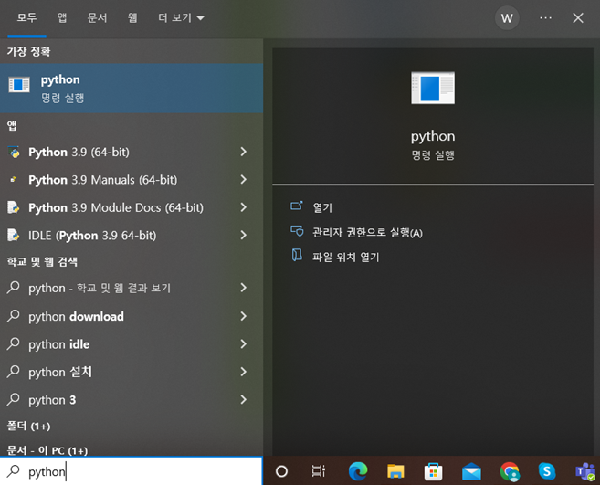
Python
Install Python
After searching for Python Make sure the installation is complete

Slide 34
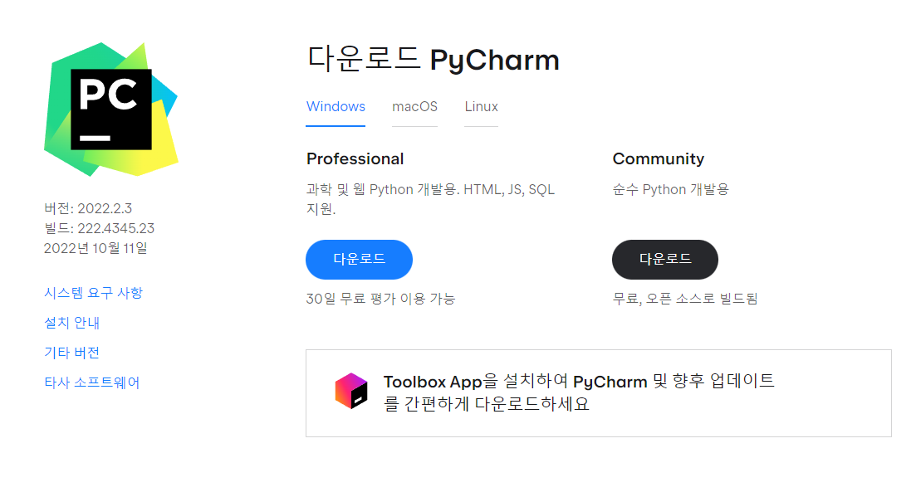
PyCharm
lnstall PyCharm
Download Page:
https://www.jetbrains.com/ko-kr/pycharm/download/#section=windows
Click

Slide 35
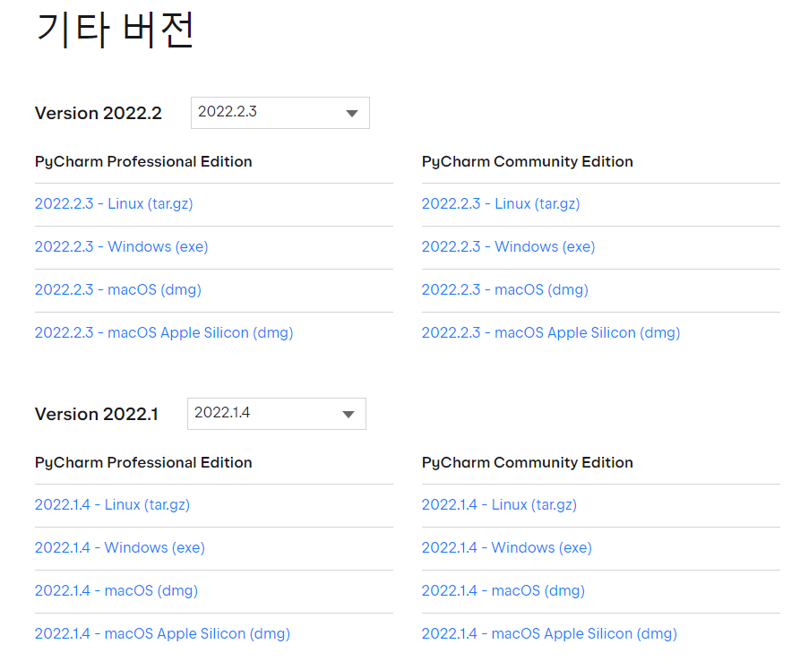
PyCharm
Install PyCharm
Click

Slide 36
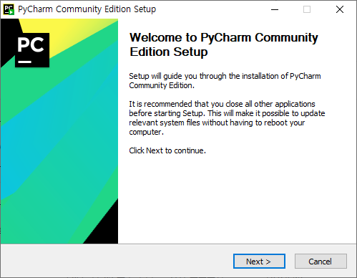
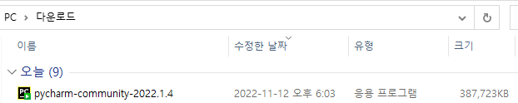
PyCharm
Install PyCharm
Click
Click

Slide 37
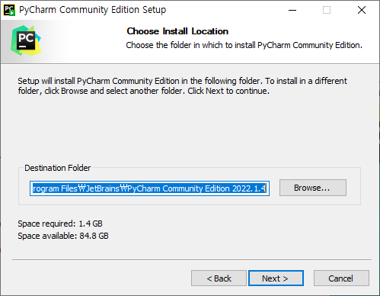
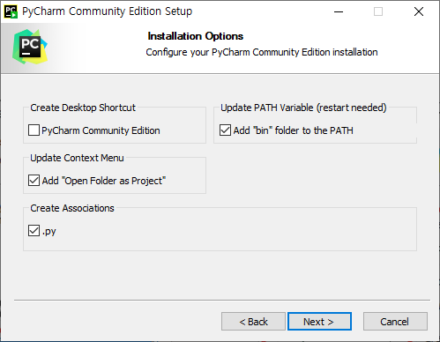
PyCharm
Install PyCharm
Check the checkbox
Choose a PyCharm path
Click
Click

Slide 38
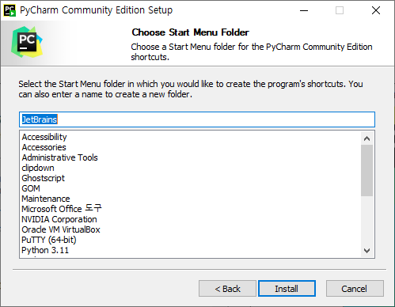
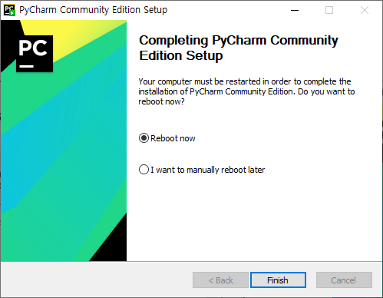
PyCharm
Install PyCharm
reboot
Click
Click

Slide 39
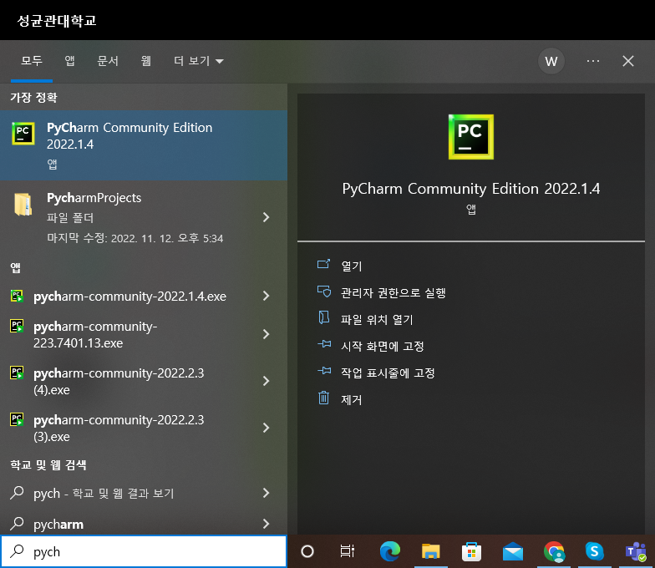
PyCharm
Interpreter setting
Run PyCharm

Slide 40
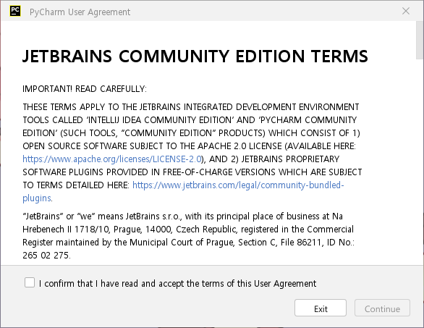

PyCharm
Interpreter setting
① Check
②Click
①Check
②Click

Slide 41

PyCharm
Interpreter setting
Click

Slide 42

PyCharm
Interpreter setting
Click

Slide 43


PyCharm
Interpreter setting
① Locate Project Files Folders (Keep Initial Value)
② check
③ Add Interpreter ->Add Local Interpreter클릭
③-1 If it pops up like this Click the ... to proceed

Slide 44

PyCharm
Interpreter setting
② Interpreter check
If you don't have an Interpreter, Python not installed Requires Python reinstallation
① Click
③ Click

Slide 45

PyCharm
Interpreter setting
When you encounter the following error:
Reinstall to 2022.1.4 version

Slide 46

PyCharm
Interpreter setting
① interpreter check
(Python 3.9)
② Click

Slide 47

PyCharm
Interpreter setting
② Click
① Python 3.9 check

Slide 48

PyCharm
Interpreter setting
'Hi, PyCharm’ is out

Slide 49

Library
Install the library
File - Settings Click

Slide 50

Library
Install the library
② '+’ Click the button
① Project: <Project Name>
-> Python Interpreter Check

Slide 51

Library
Install LiDAR library
① rplidar-roboticia search
② rplidar-roboticia check
③ Install Package Click
①
②
③

Slide 52

Library
Install LiDAR library
Check the installation success message

Slide 53

Library
Install Camera library
① opencv-python search
② opencv-python check
③ Install Package click
①
②
③

Slide 54

Library
Install Camera Library
Check the installation success message

Slide 55

Library
Install the Serial Communication Library
① pyserial search
② pyserial check
③ Install Package Click
①
②
③

Slide 56

Library
Install the Serial Communication Library
Check the installation success message

Slide 57

Exercise
Check library and device installation
Click
Run test code

Slide 58

Exercise
Check library and device installation
Printing the following phrase means Installation is done correctly

Slide 59
Thank You!
Automation Lab

